Slide 1
Bipedal Robot
PROJECT BY
TANMAY KAVATHEKAR

Slide 2
Project Overview
BIPEDALISM is a form of locomotion in which a robot moves by the means of its rear limbs or legs.
In this project on BIPEDAL robot we are trying to build a robot which has structure similar to human legs.
The BIPED will perform tasks like walking.
The Biped has 6 degrees of freedom, 3 for each leg.
The Biped will try to balance its weight on one its legs and move forward by swinging its other legs.
Mostly the Biped works autonomously depending on the input program.

Slide 3
Requirements & tasks
Tasks:
Creating a structure for the Biped use
Making the controlling circuit .
Interfacing the circuit and the motors.
Writing a program for motion of the Biped.
Using the interface to establish a smoother walking sequence for the Biped.
Requirements:
ATMEGA 640 development board.
Servo motors .
Servo arm and jacket kits

Slide 4
Project plan
First we write a program to generate PWM signals.
Then all the motors are aligned to 90 degrees.
The structure is made by using servo jackets and servo arms. The jackets hold the servo motors in place.
Next is to interface the motors with a the circuit and test it.
Then the code is further developed for autonomous control of the Biped and the robot is tested.

Slide 5
Block diagram
POWER SUPPLY
MICRO- CONTROLLER
SERVO MOTOR
EXTERNAL SUPPLY

Slide 6
Algorithm
Generally walking cycle consists of two steps namely Initialization and Walking
Initialization:
In the Initialization step the robot will be in balanced condition and in this step the servomotors are made to return to home position.
Walking:
Walking step is further classified into six phases.
Phase 1 – Double Support:
In this phase both the legs are in same line and the centre of mass is maintained between the two legs.

Slide 7
Algorithm
Phase 2 – Single Support (Pre-Swing):
In this phase both the ankle joints are in actuated in roll orientation which shifts the centre of mass towards the left leg and the right leg will be lifted up from the ground.
Phase 3 – Single Support (Swing):
In this phase, the right leg is lifted further and made to swing in the air. Hip and knee joints are actuated in pitch orientation so that right leg is moved forward.
Phase 4 – Post Swing:
In this phase the lifted leg is placed down with the actuation of ankle joints.
Phase 5 and 6
They are the mirror image of Phase 2 and Phase 3. After Phase 6, motion continues

Slide 8
Challenges & Innovation
The most challenging part of the project is the coding of the walking gait.
The Biped must balance its self while walking.
It becomes difficult to access rough terrain using normal robots with wheels, in such cases a bipedal robot can be useful.
Biped can be a boon for people who have disability in their lower limbs.
They can be used in military applications instead of soldiers.

Slide 9
Task completed
The program was written to generate PWM to control the motors. Then each motor was aligned at 90 degrees before assembly.
The structure of the biped was made using the arm and jacket kits. The arm kit was cut and modified to link the knee and servo joint.
Instead of building a circuit we have used a development board for interfacing the motors.
Also we had to take special care while programming so that the balance of the robot was maintained at every step.

Slide 10
Task completed
Assembly of the robot took time as we had to align each motor at 90 degree before and after each part was added, so that the mistakes could be rectified quickly and easily.
We tried to use more than 2 motors using the supply from the board the supply was insufficient, hence used a supply of 5V,15A.
The motion of servo was quick, hence we introduced a “for” loop so that there was a delay after every 2 degree the motor moved.
While moving from double support to pre-swing phase we tilted the ankle servo so that the CG of the robot shifted slightly over the other leg, before tilting the robot over the other leg.

Slide 11
Task completed
During the walking motion the major problem faced was that of servo jitter which causes the motor to jerk making it difficult to walk smoothly as well as maintain balance.

Slide 12
Test plan & cases
Motor testing:
First, each motor of the robot is tested for proper functioning. Then the motor are aligned at 90 degrees. When the robot is assembled each servo is aligned at 45 and 135 degrees to check the direction of motion.
Robot testing:
We tried to tilt the robot on one leg, but it did not balance itself and toppled immediately.
While tilting the robot over one leg we observed that the motion was too sudden.

Slide 13
Test plan & cases
Then we went forward create a sideways motion by tilting the ankle joint and pushing it suddenly to the ground. We get better motion if the surface is plain.
Then we move forward to perform a kicking motion.
After kicking the next step was to complete the entire walking motion. During the walking motion the major problem faced was that of servo jitter which causes the motor to jerk making it difficult to walk smoothly as well as maintain balance.
The output for various phases are shown:

Slide 14
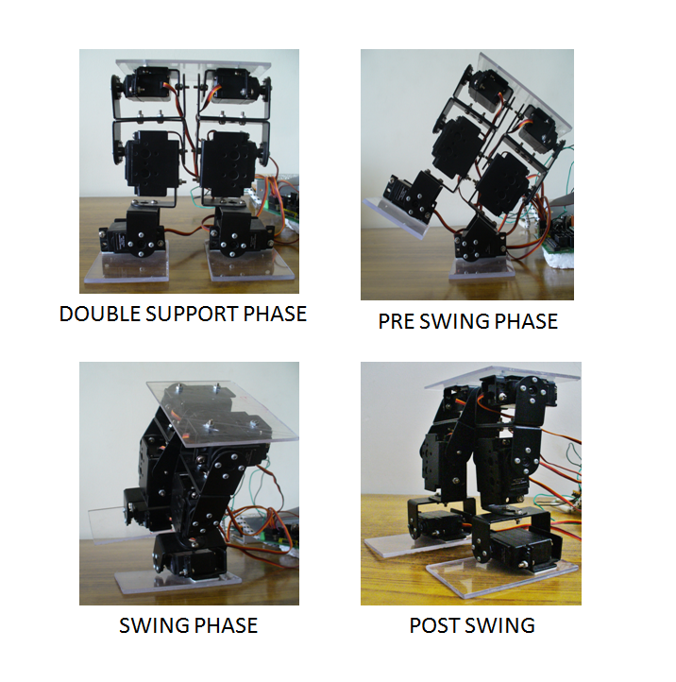
Test plan & cases

Slide 15
Future enhancements
We can attach I/R sensors to detect obstacles.
Force sensors can be used for better balance.
A circuit powered by Li-ion can be used to create a autonomous robot.
The robot can be controlled via X’bee wirelessly.
The upper body of the robot can be added to create a complete humanoid.

Slide 16
Thank You

